Slide 1
Pivotal Cloud Foundry
Jan 2017

Slide 2
PCF -DAY 01

Slide 3
Why Cloud?
Shared Resources
Dynamic Scaling
Pay as you Use
High Availability
High Productivity
Environment friendly
Less Deployment Time

Slide 4
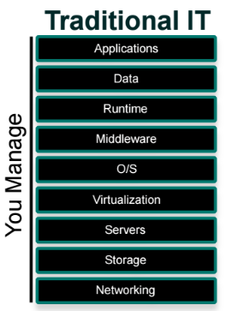
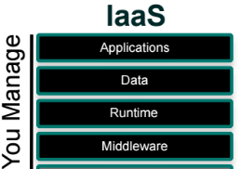

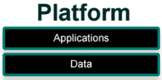
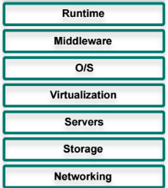

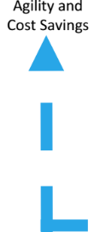
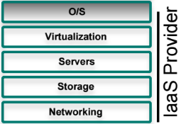
What is PaaS

Slide 5
Deploying Applications
IAAS vs PCF
Common application needs are handled by the platform so we can focus on the business value
Configure Firewall
Configure service connectivity
Configure SSL Termination
Configure Load balancer
Deploy Application
Install Application runtime
Provision a VM

Slide 6
Scaling Applications
IAAS vs PCF
Cf scale
Configure Firewall
Configure service connectivity
Configure SSL Termination
Configure Load balancer
Deploy Application
Install Application runtime
Provision a VM

Slide 7
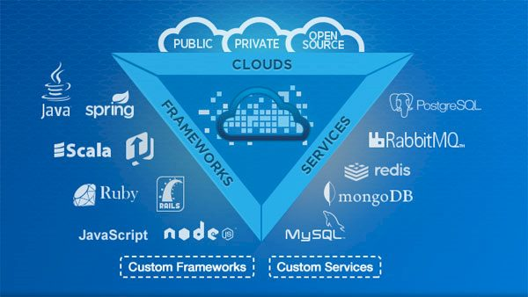
What is cloud Foundry
Cloud Foundry (CF) is an open source cloud platform and has become the industry standard on which developers can build,deploy run and scale applications on public and private cloud models.

Slide 8
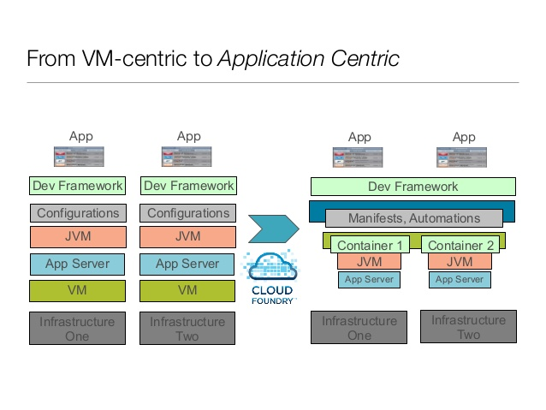
VM Centric to App Centric

Slide 9
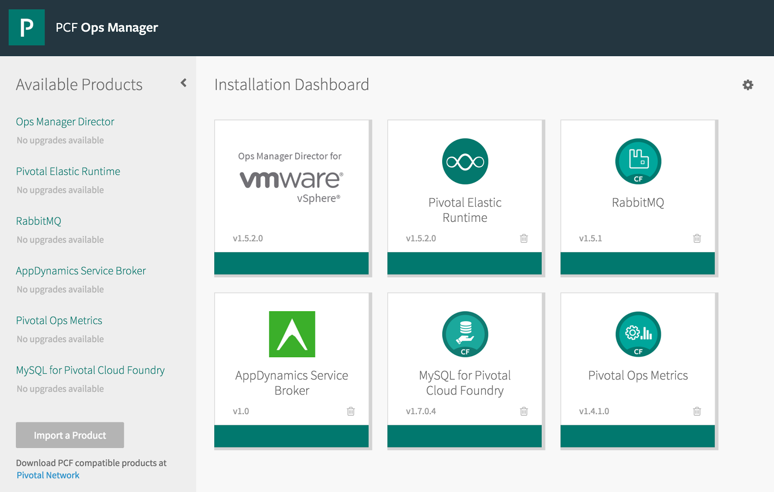
Pivotal CF – Ops Manager

Slide 10
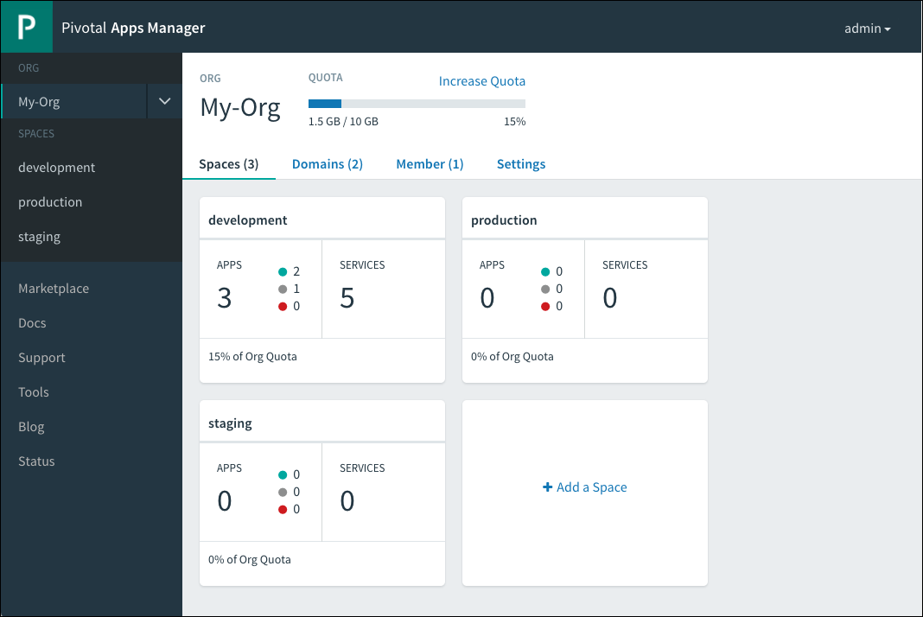
Pivotal CF – Apps Manager

Slide 11
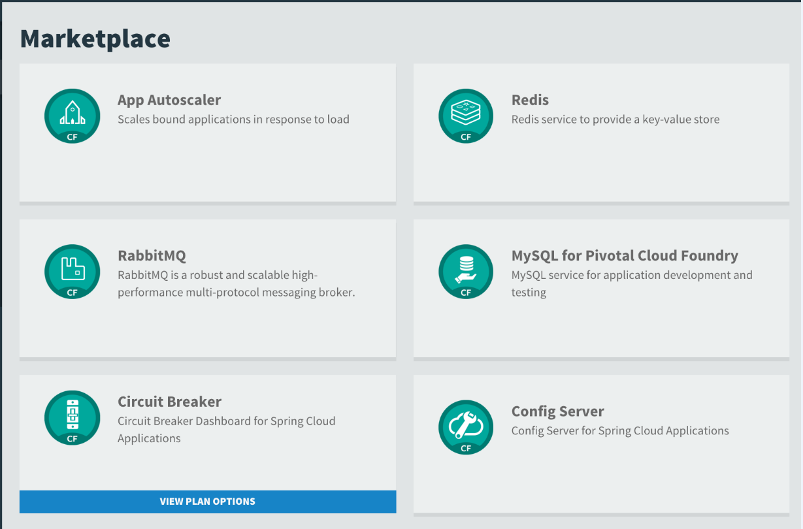
Pivotal CF - services

Slide 12
Pivotal Cloud Foundry – Core Tenets
Self service platform for Developers
Cf push
Service marketplace
Microservice Ready
Operationaly Robust
Elastic scale
High availability
Metrics
Logs
Quotas
Iaas Independent
AWS
Vmware
Openstack
Azure

Slide 13
Pivotal Offerings
Public – Pivotal web services [run.pivotal.io]
Private – enterprise setup
Local – PCFDev

Slide 14
Fundamental Changes
Distributed system
Distributed system are hard to build, test, manage and scale
Ephemeral Infrastructure
Virtual Machines and Containers are temporary
Immutable infrastructure
Updates to systems and applications are not done in-place but rather new, updated instances are created instead

Slide 15

Pivotal CF Architecture
Elastic runtime
HA Proxy LB
Dynamic Router
Services
Operations Manager
Ops manager UI
Cloud Controller
Diego Brain
Service broker
Cell Reps
Login Server
Ops manager director
Cell
Service nodes
Apps
Apps
NATS Messaging
BBS
Loggregator
Metric collector
vmware
Openstack
AWS
azure

Slide 16
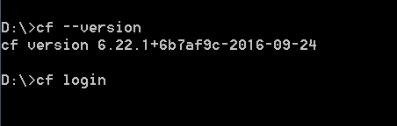
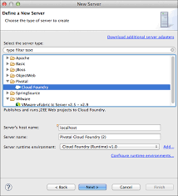
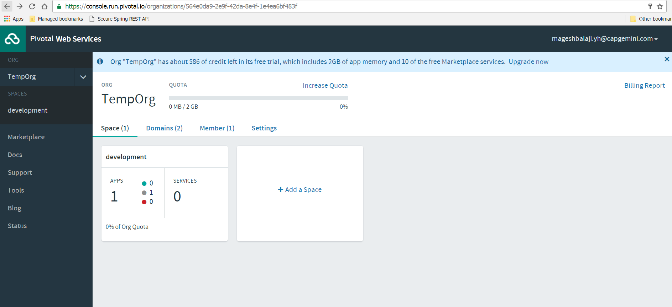
Interface Options
Command Line Interface
Web Console
Eclipse/STS Plugin

Slide 17




CF Key Terminologies
Orgs
Top Most Organizational Unit.
It contains Users,Spaces and Domains
We mostly define routes, apps and services
Spaces
Every application and service is scoped to a space.
Each org contains at least one space.
Space provides users with access to a shared location for app development, deployment, and maintenance.
User Accounts
A user account represents an individual person within the context of a CF installation.
A user can have different roles in different spaces within an org, governing what level and type of access they have within that space.
Roles &Permissions
A user can have one or more roles.
The combination of these roles defines the user’s overall permissions in the org and within specific spaces in that org.

Slide 18
CF CLI commands
CF Help
E.g.
cf help
Use cf login to log in to Elastic Runtime.
E.g.
cf login [-a API_URL] [-u USERNAME] [-p PASSWORD] [-o ORG] [-s SPACE]
Commands for Listing Users:
E.g.
cf org-users
cf space-users
Command to Logout
E.g.
cf logout

Slide 19
CF CLI commands
List down apps
E.g. cf apps
To know the status of the app
E.g. cf app APP_NAME
The cf push command pushes a new app or syncs changes to an existing app.
Creating app my-awesome-app in org example-org
E.g. cf push my-awesome-app -b https://github.com/cloudfoundry/java-buildpack.git
The cf help command lists the cf CLI commands and a brief description of each.
E.g. cf delete –h
Commands for Managing Roles
E.g.
cf set-org-role (cf set-org-role huey@example.com example-org OrgManager)
cf unset-org-role
cf set-space-role
cf unset-space-role

Slide 20
Domains and URL
Every CF instance is assigned a domain while installation
When app is deployed it gets a unique route (URL) to access it
URL = HOSTNAME+DOMAIN
By default hostname is app name
Hostname should be unique

Slide 21
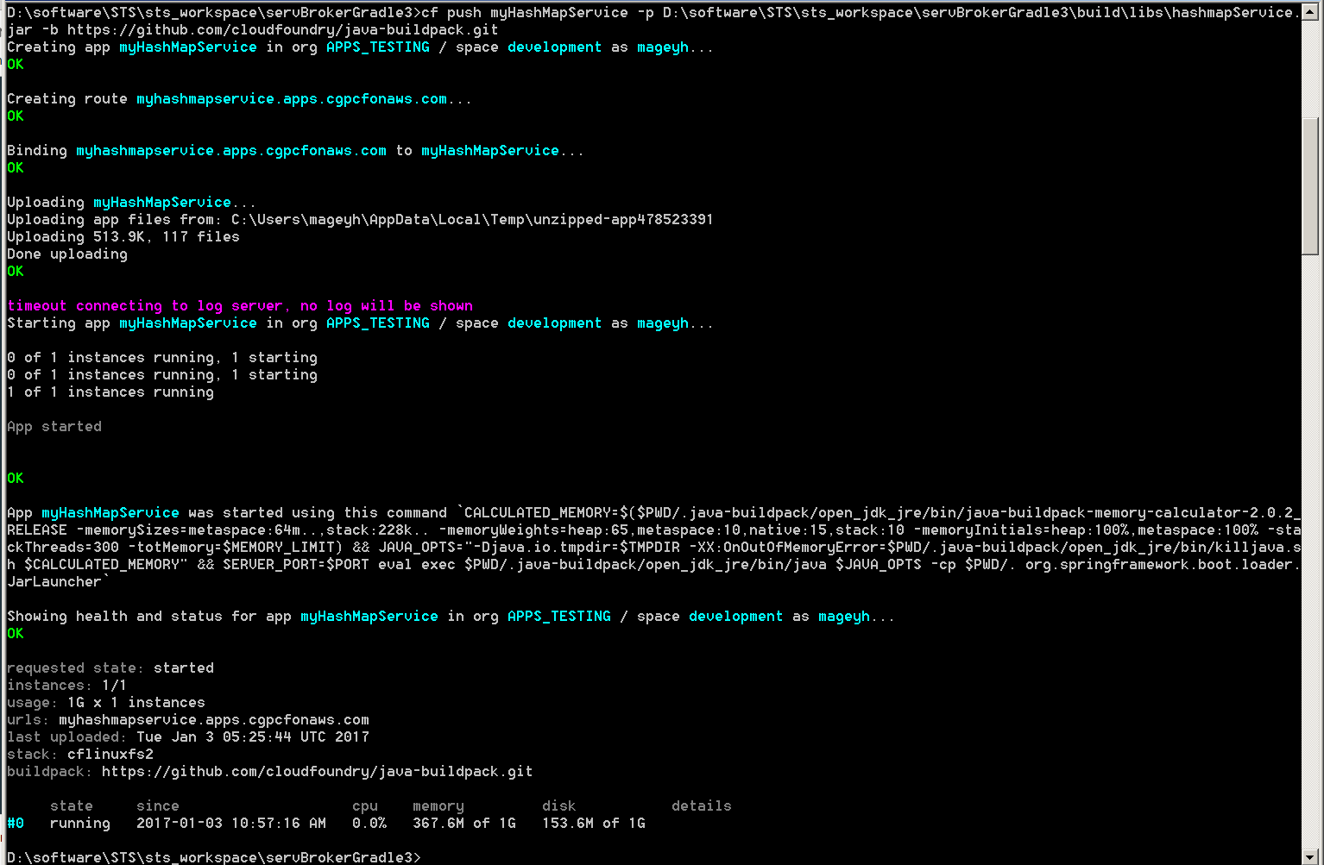
App Deployment through CLI

Slide 22
What Just Happened ?
Deployed an app to PCF by running a cf push command from the Cloud Foundry Command Line Interface (cf CLI).
E.g. cf push my-app –I 1 –m 512M –k 1G
The command does few operation at the background:
Uploads and stores app files
Examines and stores app metadata
Creates a “droplet” (the Cloud Foundry unit of execution) for the app
Selects an appropriate Diego cell to run the droplet
Starts the app
STAGING

Slide 23
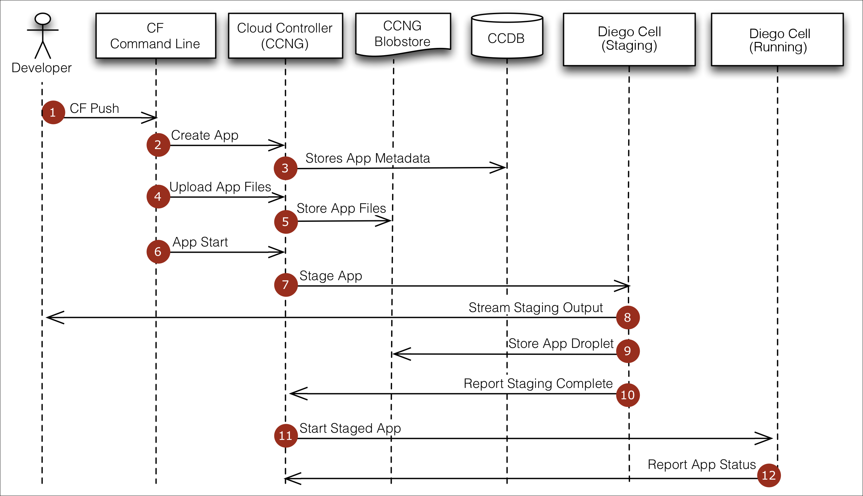
Staging!

